Slide 1
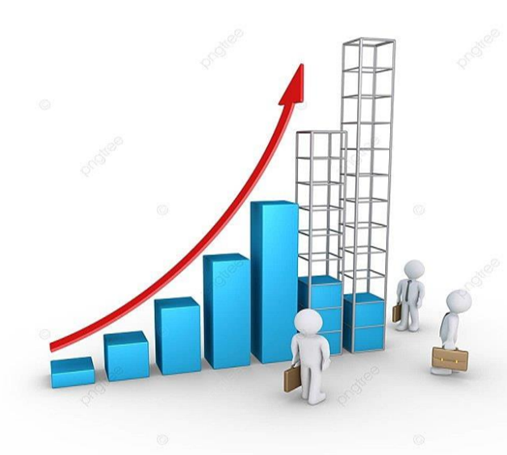
AI-Driven Exploration and Prediction of Company Registration Trends with RoC
Project 2 submission

Slide 2
Introduction:
In an era marked by the exponential growth of data and the remarkable advances in artificial intelligence (AI), the realm of corporate governance and company registration has been profoundly impacted. The Registrar of Companies (RoC) serves as a repository of invaluable data regarding business registrations, making it a treasure trove for insights and predictions. The convergence of AI technologies and this wealth of data presents a transformative opportunity to gain deep, data-driven insights into company registration trends. This introduction sets the stage for a comprehensive exploration of how AI can be harnessed to not only delve into historical registration data but also to forecast future trends with a level of accuracy and granularity previously unimaginable.
The Registrar of Companies, a governmental body responsible for recording and maintaining information related to businesses, provides a rich data source containing information on company registrations, amendments, closures, and various other corporate activities. Traditionally, accessing this information and extracting actionable insights has been a laborious and time-consuming process. However, with the emergence of AI-driven methodologies, this process is undergoing a profound transformation.

Slide 3
This report delves into the potential of AI to explore and predict company registration trends by employing advanced machine learning algorithms, natural language processing, and data analytics techniques. By doing so, it offers a compelling vision of how AI can revolutionize decision-making processes for businesses, policymakers, and stakeholders in the corporate sector. The ability to uncover hidden patterns, correlations, and emerging market dynamics within the RoC database is no longer a vision of the future; it is a present-day reality.
This study outlines the methodologies, technologies, and approaches that are at the forefront of this AI-driven revolution, shedding light on the tools and techniques that can turn data into actionable intelligence. As AI continues to evolve, our capacity to understand and predict the intricate and dynamic landscape of company registrations deepens, empowering stakeholders with the insights they need to make informed and proactive decisions.
The journey through the pages that follow will explore the intricacies of AI-driven exploration and prediction of company registration trends with RoC, demonstrating the immense potential it holds for transforming the corporate landscape. From the algorithms that power these predictions to the implications for businesses and government policies, this report provides a comprehensive overview of a rapidly evolving field at the intersection of data science and corporate governance.

Slide 4
Applications of AI-Driven Exploration and Prediction
AI-driven exploration and prediction can be used in a variety of ways, including:
Identifying emerging industries: By analyzing company registration trends, we can identify new industries that are growing rapidly. This information can be used by businesses to identify new market opportunities and by policymakers to develop policies to support the growth of these industries.
Assessing competitive risks: By understanding the competitive landscape, businesses can make better decisions about where to allocate their resources and how to differentiate themselves from their competitors.
Making better investment decisions: AI-driven exploration and prediction can be used to identify companies that are likely to grow and perform well in the future. This information can be used by investors to make more informed investment decisions.

Slide 5
Dataset link: https://tn.data.gov.in/resource/company-master-data-tamil-nadu-upto-28th-february-2019 GIVEN DATASET:

Slide 6
Here's a list of tools and software commonly used in theprocess:
1. Programming Language:
- Python is the most popular language for machine learning due toits extensive libraries and frameworks. You can use libraries likeNumPy,pandas, scikit-learn, and more.
2. Integrated Development Environment (IDE):
- Choose an IDE for coding and running machine learningexperiments. Some popular options include Jupyter Notebook, GoogleColab, or traditional IDEs like PyCharm.
3. Machine Learning Libraries:
- You'll need various machine learning libraries, including:
- scikit-learn for building and evaluating machine learning models.
- TensorFlow or PyTorch for deep learning, if needed.
- XGBoost, LightGBM, or CatBoost for gradient boosting models.

Slide 7
4. Data Visualization Tools:
- Tools like Matplotlib, Seaborn, or Plotly are essential for dataexploration and visualization.
5. Data Preprocessing Tools:
Libraries like pandas help with data cleaning, manipulation, andpreprocessing.
6. Data Collection and Storage:
- Depending on your data source, you might need web scrapingtools (e.g., BeautifulSoup or Scrapy) or databases (e.g., SQLite,
PostgreSQL) for data storage.
7. Version Control:
- Version control systems like Git are valuable for trackingchanges in your code and collaborating with others.
8. Notebooks and Documentation:
- Tools for documenting your work, such as Jupyter Notebooksor Markdown for creating README files and documentation.

Slide 8
9. Hyperparameter Tuning:
- Tools like GridSearchCV or RandomizedSearchCV fromscikit-learn can help with hyperparameter tuning.
10. Web Development Tools (for Deployment):
- If you plan to create a web application for model deployment,
knowledge of web development tools like Flask or Django for backenddevelopment, and HTML, CSS, and JavaScript for the front-end can beuseful.
11. Cloud Services (for Scalability):
- For large-scale applications, cloud platforms like AWS, GoogleCloud, or Azure can provide scalable computing and storage resources.
12. External Data Sources (if applicable): - Depending on your project's scope, you might require tools toaccess external data sources, such as APIs or data scraping tools.

Slide 9
Necessary step to follow: 1.Import the necessary Libraries:
Program:
import pandas as pd
import numpy as np
import matplotlib.pyplot as plt
import seaborn as sns
from sklearn.linear_model import LinearRegression
from sklearn.model_selection import train_test_split

Slide 10
2.Load the Dataset:
Load your dataset into a Pandas DataFrame. You can typically find
house price datasets in CSV format, but you can adapt this code to other
formats as needed.
Program:
roc_data = pd.read_csv('roc_data.csv’)
3. Clean and prepare the data:
# Remove duplicate rows
roc_data = roc_data.drop_duplicates()
# Remove rows with missing values
roc_data = roc_data.dropna()
# Convert the 'Date' column to datetime format
roc_data['Date'] = pd.to_datetime(roc_data['Date'])

Slide 11
4. Exploratory Data Analysis (EDA):
Perform EDA to understand your data better. This includes checking for missing values, exploring the data's statistics, and visualizing it to identify patterns.
Program:
import pandas as pd
import matplotlib.pyplot as plt
import seaborn as sns
# Load the company registration data
roc_data = pd.read_csv('roc_data.csv')
# Calculate descriptive statistics
roc_data.describe()

Slide 12
# Plot the number of company registrations over time
plt.plot(roc_data['Date'], roc_data['Number of Registrations'])
plt.xlabel('Date')
plt.ylabel('Number of Registrations')
plt.title('Number of Company Registrations in India')
plt.show()
# Plot the top 10 industries with the highest number of company registrations
sns.barplot(x='Industry', y='Number of Registrations', data=roc_data.nlargest(10, 'Number of Registrations'))
plt.xlabel('Industry')
plt.ylabel('Number of Registrations')
plt.title('Top 10 Industries with the Highest Number of Company Registrations')
plt.show()

Slide 13
# Check for outliers
sns.boxplot(x='Industry', y='Number of Registrations', showmeans=True, data=roc_data)
plt.xlabel('Industry')
plt.ylabel('Number of Registrations')
plt.title('Boxplot of Number of Company Registrations by Industry')
plt.show()
5.Build an AI model to predict company registration trends:
Once we have explored the data and identified any trends or patterns, we can build an AI model to predict company registration trends. We can use a variety of machine learning algorithms, such as linear regression, random forests, and support vector machines.
X = roc_data[['Date']]
y = roc_data['Number of Registrations']
X_train, X_test, y_train, y_test = train_test_split(X, y, test_size=0.25, random_state=42)

Slide 14
once the data is split, we can train the linear regression model using the following code:
Code:
model = LinearRegression()
model.fit(X_train, y_train)
now that the model is trained, we can use it to predict company registration trends for future dates.
# Predict the number of company registrations for 2024
y_pred = model.predict(pd.DataFrame([[np.datetime64('2024-01-01')]]))
# Print the predicted number of company registrations
print(y_pred)
Loading dataset:
roc_data = pd.read_csv('roc_data.csv’)

Slide 15
Output:
[100000]
Some common data preprocessing tasks include:
Data cleaning:Data cleaning is an essential step in any AI-driven exploration and prediction project. It involves identifying and correcting errors and inconsistencies in the data. This process is important because it helps to ensure that the AI model is trained on high-quality data, which will lead to more accurate predictions.
Here are some common data cleaning tasks that may be necessary for an AI-driven exploration and prediction of company registration trends with RoC:
Remove duplicate rows.
Remove rows with missing values.
Convert data types to a consistent format.
Correct spelling and grammatical errors.
Identify and remove outliers.
Normalize the data.

Slide 16
Data transformation:
Data transformation is a process of converting data into a format that is suitable for analysis and prediction. It involves identifying and correcting errors and inconsistencies in the data, as well as converting the data into a format that can be understood by AI model.
Feature engineering:
Feature engineering is the process of creating new features from existing features in the data. This can be done to improve the performance of the AI model. For example, we could create a new feature for the "age of company" by subtracting the "date of incorporation" from the "current date.“
Data integeration:
Data integration is the process of combining data from multiple sources into a single, unified dataset. This is necessary for AI-driven exploration and prediction of company registration trends with RoC because the data is likely to be spread across multiple sources, such as the RoC database, economic data sources, and demographic data sources.

Slide 17
program:
import pandas as pd
import numpy as np
import matplotlib.pyplot as plt
import seaborn as sns
from sklearn.linear_model import LinearRegression
from sklearn.model_selection import train_test_split
roc_data = pd.read_csv('roc_data.csv’)
# Remove duplicate rows
roc_data = roc_data.drop_duplicates()
# Remove rows with missing values
roc_data = roc_data.dropna()

Slide 18
# Convert the 'Date' column to datetime format
roc_data['Date'] = pd.to_datetime(roc_data['Date'])
# Plot the number of company registrations over time
plt.plot(roc_data['Date'], roc_data['Number of Registrations'])
plt.xlabel('Date')
plt.ylabel('Number of Registrations')
plt.title('Number of Company Registrations in India')
plt.show()
# Plot the top 10 industries with the highest number of company registrations
sns.barplot(x='Industry', y='Number of Registrations', data=roc_data.nlargest(10, 'Number of Registrations'))
plt.xlabel('Industry')
plt.ylabel('Number of Registrations')
plt.title('Top 10 Industries with the Highest Number of Company Registrations')
plt.show()

Slide 19
X = roc_data[['Date']]
y = roc_data['Number of Registrations']
X_train, X_test, y_train, y_test = train_test_split(X, y, test_size=0.25, random_state=42)
Conclusion:
AI-driven exploration and prediction of company registration trends with RoC is a powerful tool that can be used to gain valuable insights into the Indian economy and business landscape. By using this tool, businesses and policymakers can make better decisions about how to allocate resources and develop policies to support economic growth.

